Slide 1

STUDENT INTERNSHIP MANAGEMENT SYSTEM
1

Slide 2

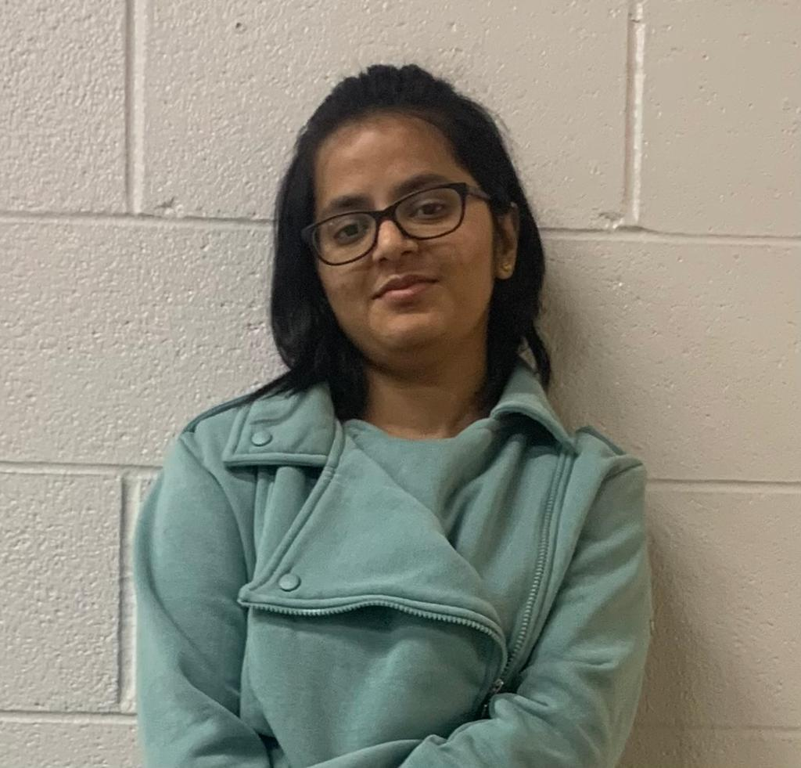
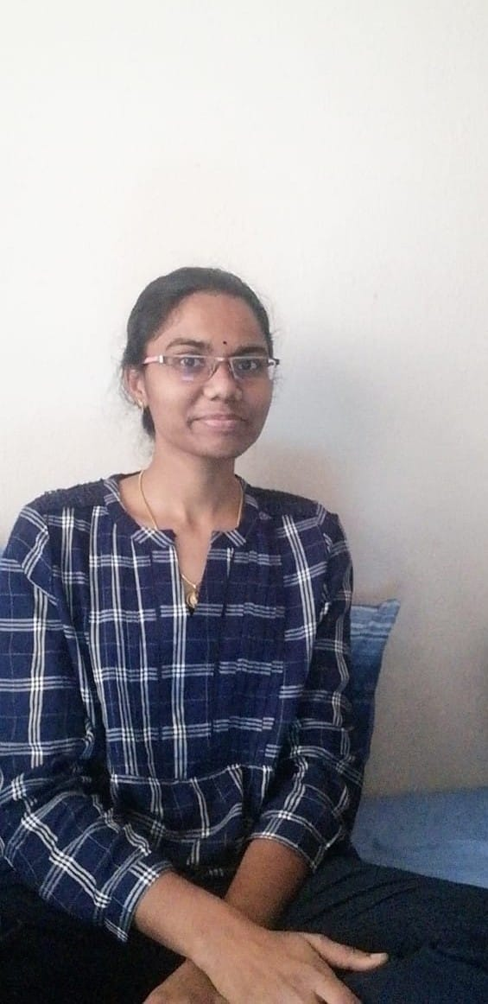
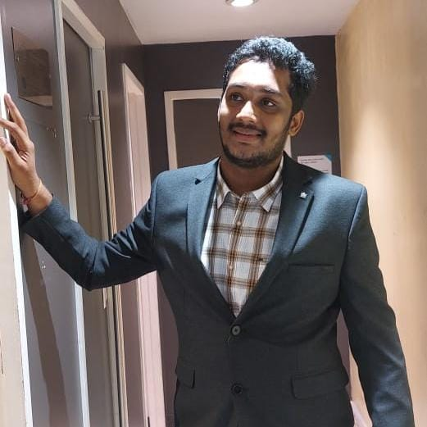


TEAM - 04
SHASHANK CHENNU - Frontend
ANUSHA POREDDY-
DataBase and Team Lead
PARIMALLA POKURI -
Backend
SAI KRISHNA GADEE –
Backend
MANIKANTA ARUMILLI –
Frontend
Dr.CHANDRA MOULI KOTTETI
Client & Mentor
2

Slide 3
Agenda
Introduction
Languages
Web pages
ER Diagram
Lessons Learnt
Outcomes
Future Implements
Summary
Presenter: Shashank Chennu
3

Slide 4


Introduction
Student Internship Management System is a crucial component of communication between students, educational institutions, and businesses.
This application helps the students to find easy way employment.
Student Internship Management System
Presenter: Shashank Chennu
4

Slide 5
Introduction cont’d…
Student Internship Management System increase your character strength, professional ability, and prospects.
By investing in internships, you'll give yourself the broadest spectrum of opportunity when seeking and applying for a job after college.
Presenter: Shashank Chennu
5

Slide 6
Introduction to application
• Student Internship Management System is a Web-based application that serves as a link between students and employers.
• In this application we have three users
1.Student
2.Employer
3.Administrator
Presenter: Shashank Chennu
6

Slide 7
Introduction to application cont’d…
• Students need to register to an application and can look for employment opportunities and submit applications.
• Companies can assess the student applications, accept or reject the application and then recruit the applicants.
• Here we have an issue either students or company employee can create a fake data and post a fake job post.
Presenter: Shashank Chennu
7

Slide 8
Introduction to application cont’d…
• To resolve this issue we have created an administrator log in.
• Administrator who has the authority to prevent the bogus data from being generated by either students or businesses.
Presenter: Shashank Chennu
8

Slide 9
Advantages
• Easily accessible.
• Easy modification.
• Provide best security.
• Time saving.
• Easy to operate and work with.
• User friendly interface.
Presenter: Shashank Chennu
9

Slide 10
Languages used
Front End: Hyper Text Markup Language(HTML), Cascading Style Sheet(CSS), Java Script(JS).
Back End Technology: Node.js, Express.js.
Database: MongoDB and Robot 3T.
Presenter: Shashank Chennu
10

Slide 11
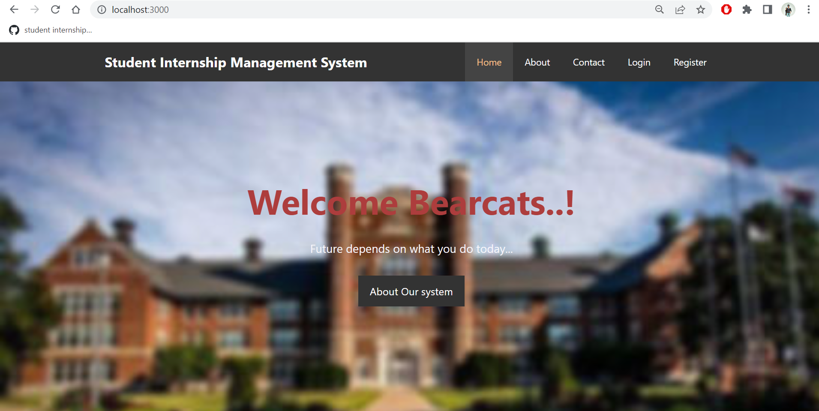
Home page
Home Screen
Fig 1 : Home Page
Presenter: Anusha Poreddy
11

Slide 12
About home page
Here in this home page, we are given a tabs for Sign-up and Sign-in for registration and login to their account.
We also have contact tab to help the users, if they are facing any issues in using application.
We do have About button where everyone can know about the uses of internships and also about the application.
Finally we have home button to redirect to the home web page.
Presenter: Anusha Poreddy
12

Slide 13
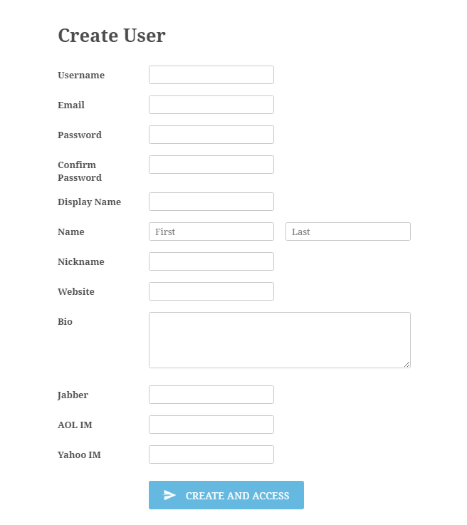
Registration Page
Registration Page or signup page
The fig shown is the sample register page for anyone to create an account to any of the web page or android application.
In our project , Registration pages are designed in such a way to differentiate the users like Student, Admin and company.
Fig 1 : sample register page
Presenter: Anusha Poreddy
13

Slide 14
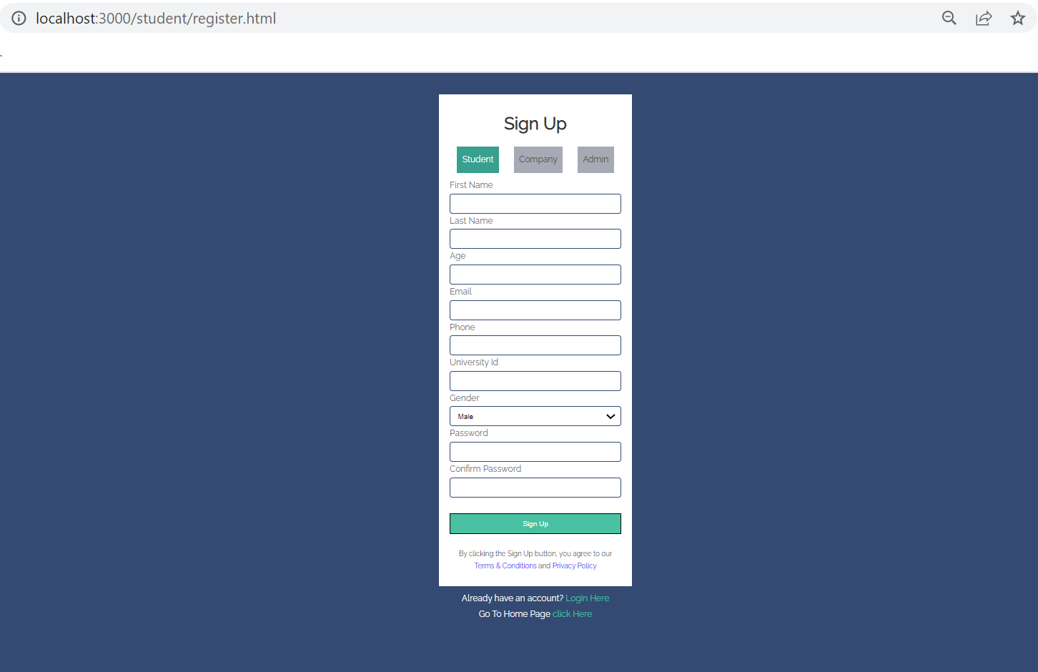
Fig 2 : student register page
Presenter: Anusha Poreddy
14

Slide 15
Student Registartion Page
In Student registration page, people who are interested to apply for jobs to gain experience need to create an account.
They need to fill up their basic details like First and Last name,email ID, unique ID, user name,Age, password fields to use the application.
Presenter: Anusha Poreddy
15

Slide 16
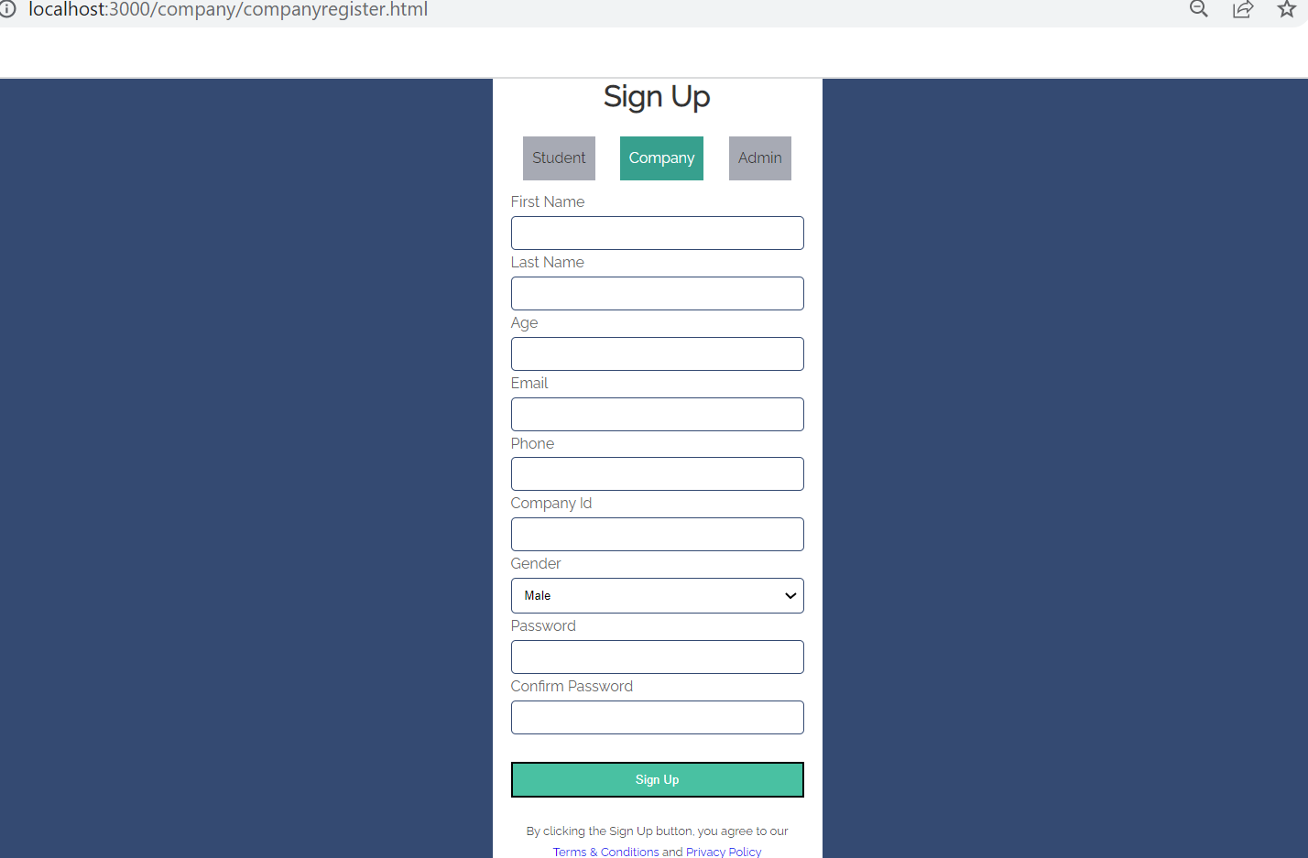
Fig 3 : Company register page
Presenter: Anusha Poreddy
16

Slide 17
Company registration page…
In Company registration page, people like HR for a company who are interested to post the job offers available within their company can create an account to use the application.
Similar to the student register page, company registration fields are also similar.
Presenter: Anusha Poreddy
17

Slide 18
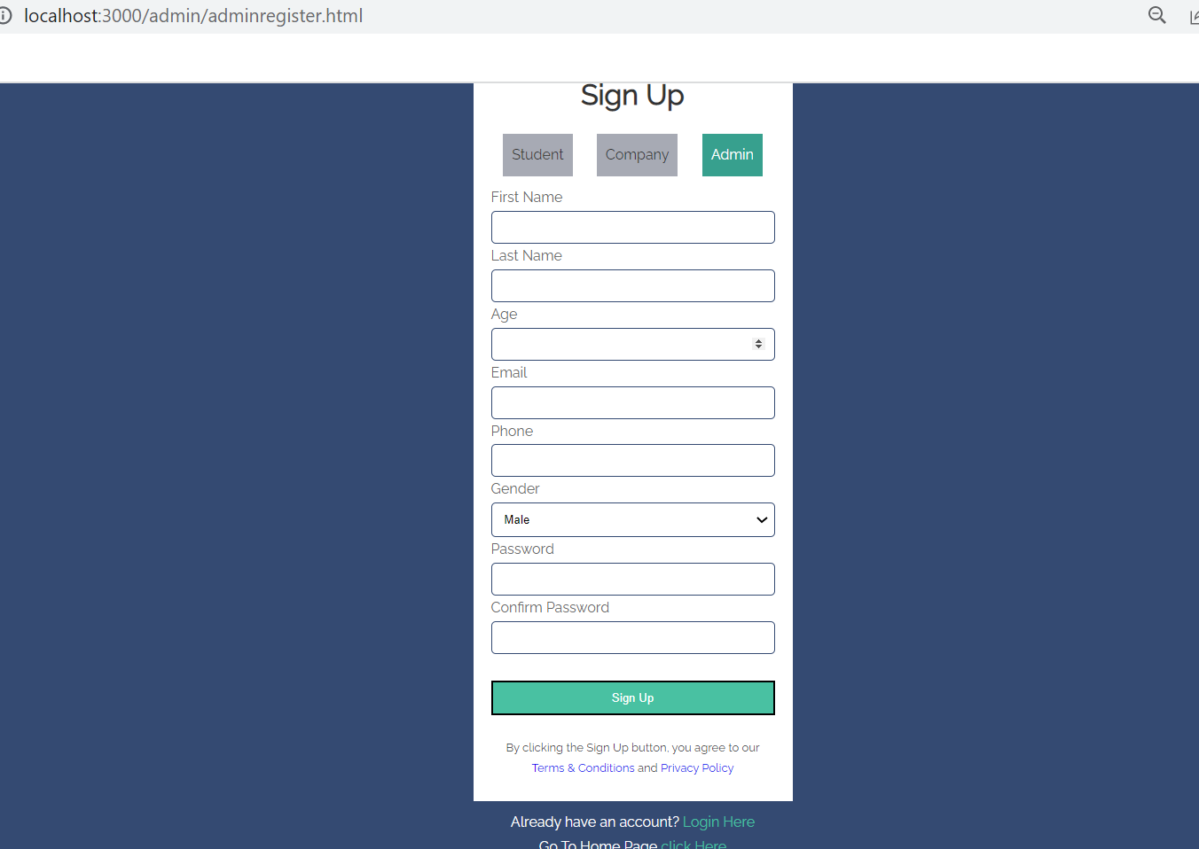
Fig 4 : Admin register page
Presenter: Anusha Poreddy
18

Slide 19
Admin registration page
In Admin registration page, only one person can register as an admin and monitor the students and company activities.
Similar to the student register page, administrator also need to fill up registration fields to activate their account.
Presenter: Anusha Poreddy
19

Slide 20
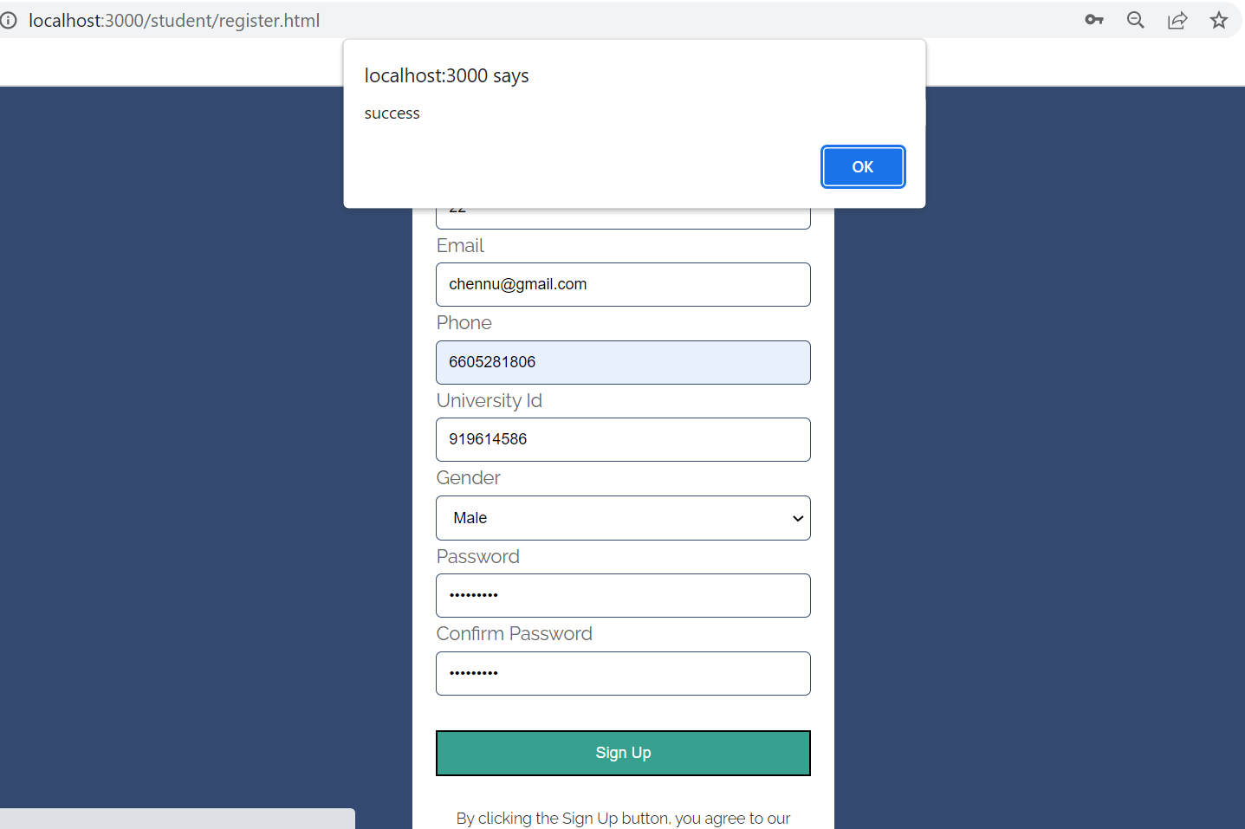
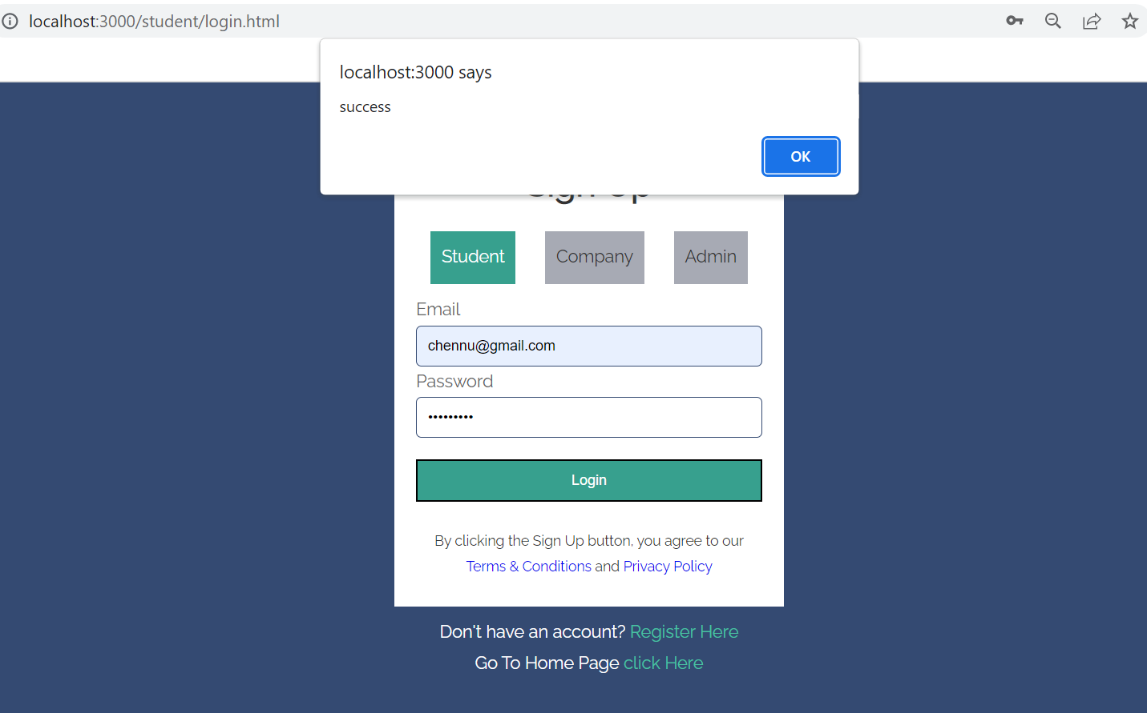
Fig 5 : Register and login page for Student Successful data entry
Presenter: Anusha Poreddy
20

Slide 21
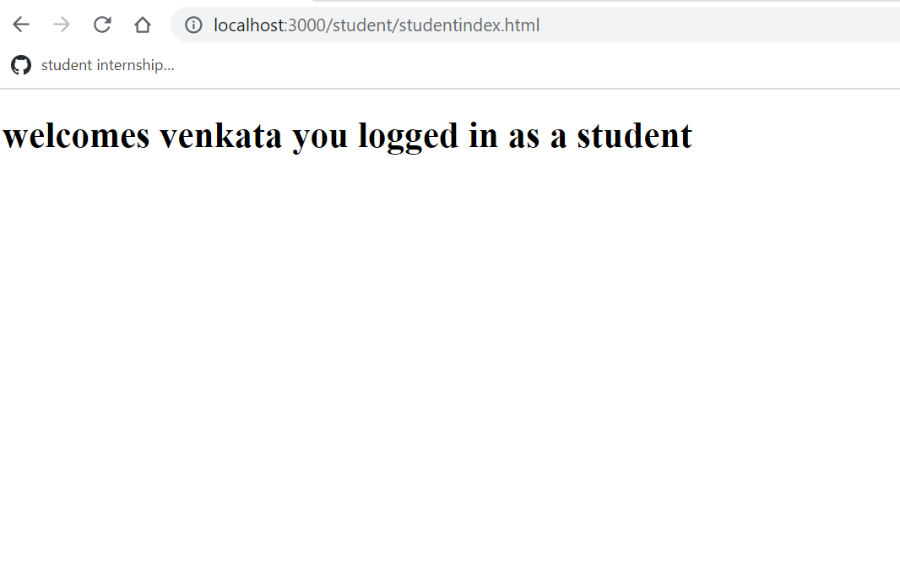
Fig 6 : DashBoard for Student after successful login
Presenter: Anusha Poreddy
21

Slide 22
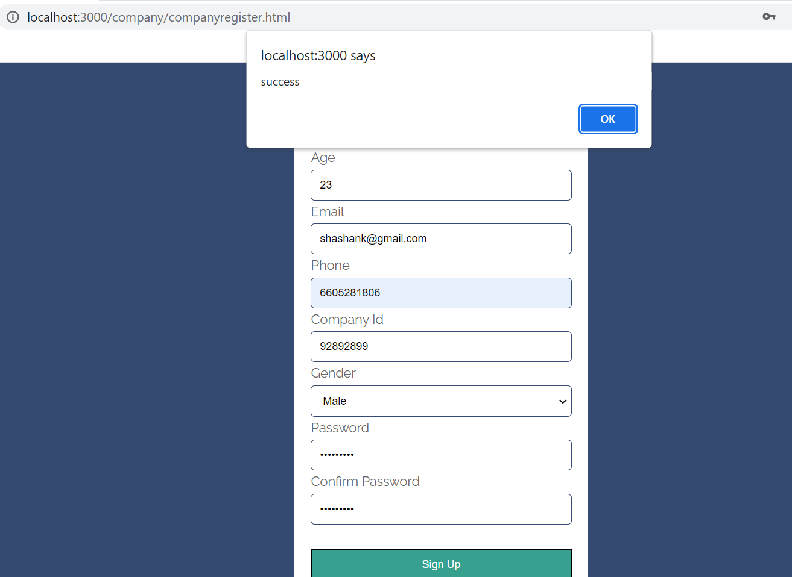
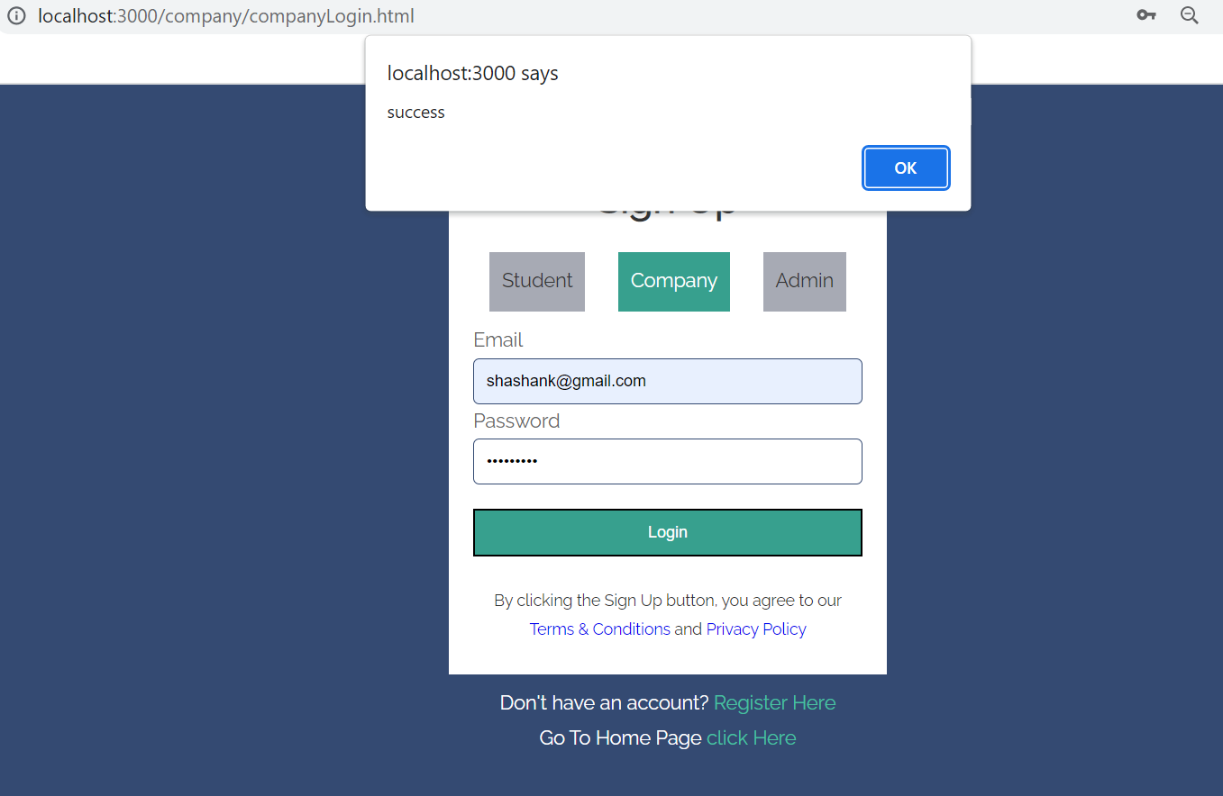
Fig 7 : Register and login page for company Successful data entry
Presenter: Anusha Poreddy
22

Slide 23
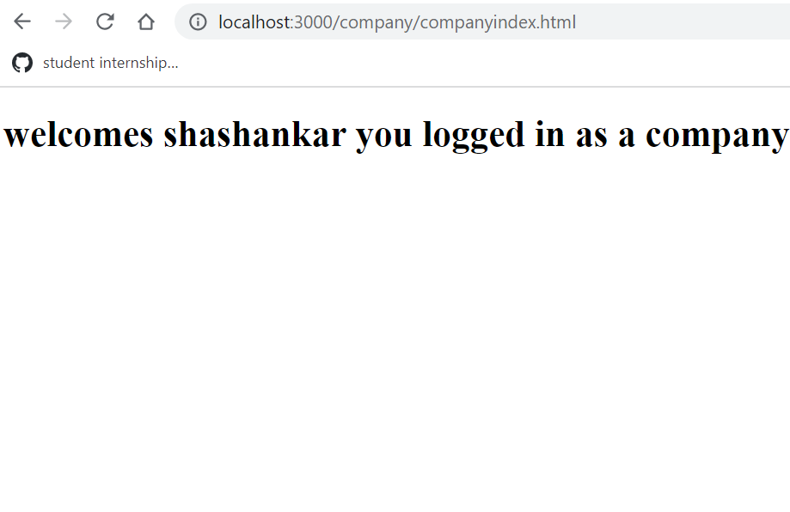
Fig 8 : DashBoard for Company after successful login
Presenter: Anusha Poreddy
23

Slide 24
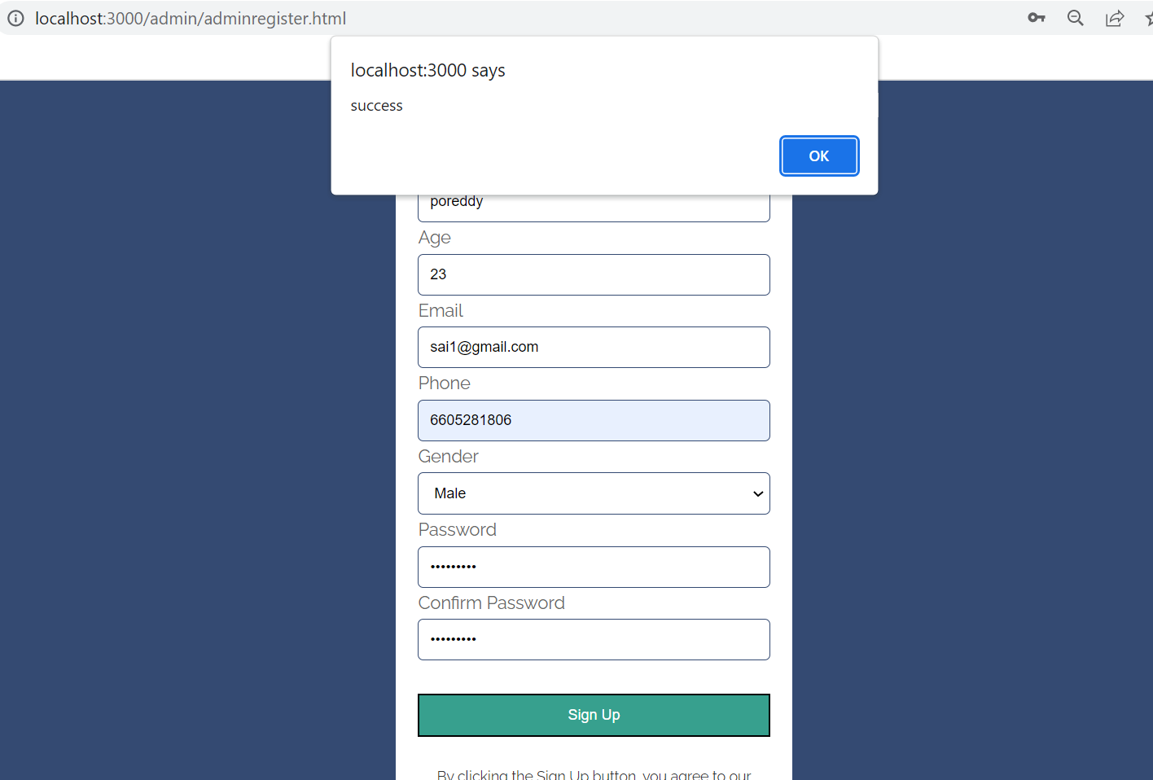
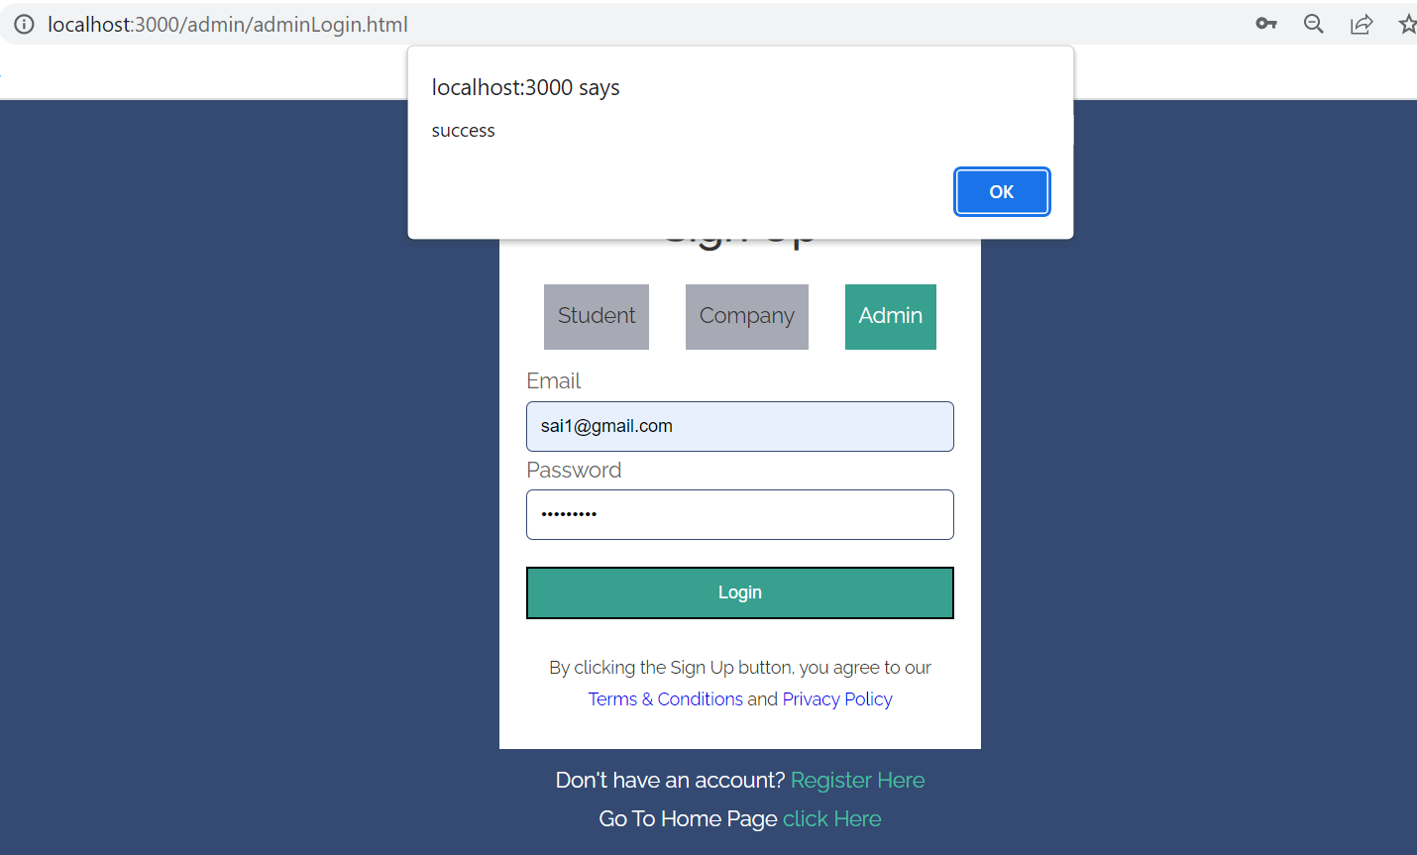
Fig 9 : Register and login page for Admin Successful data entry
Presenter: Anusha Poreddy
24

Slide 25
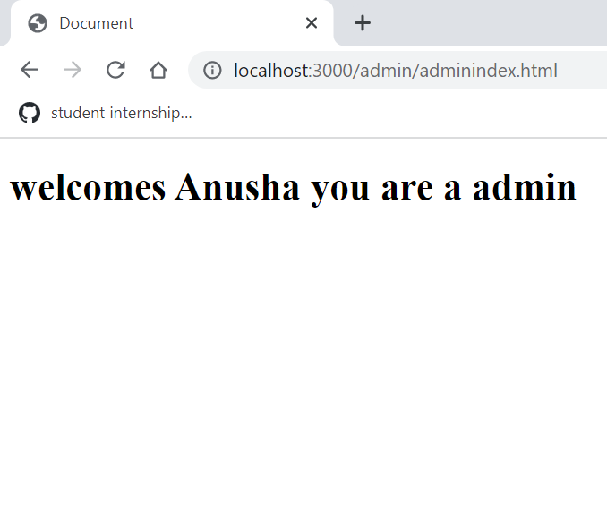
Fig 10 : DashBoard for Admin after successful login
Presenter: Anusha Poreddy
25

Slide 26
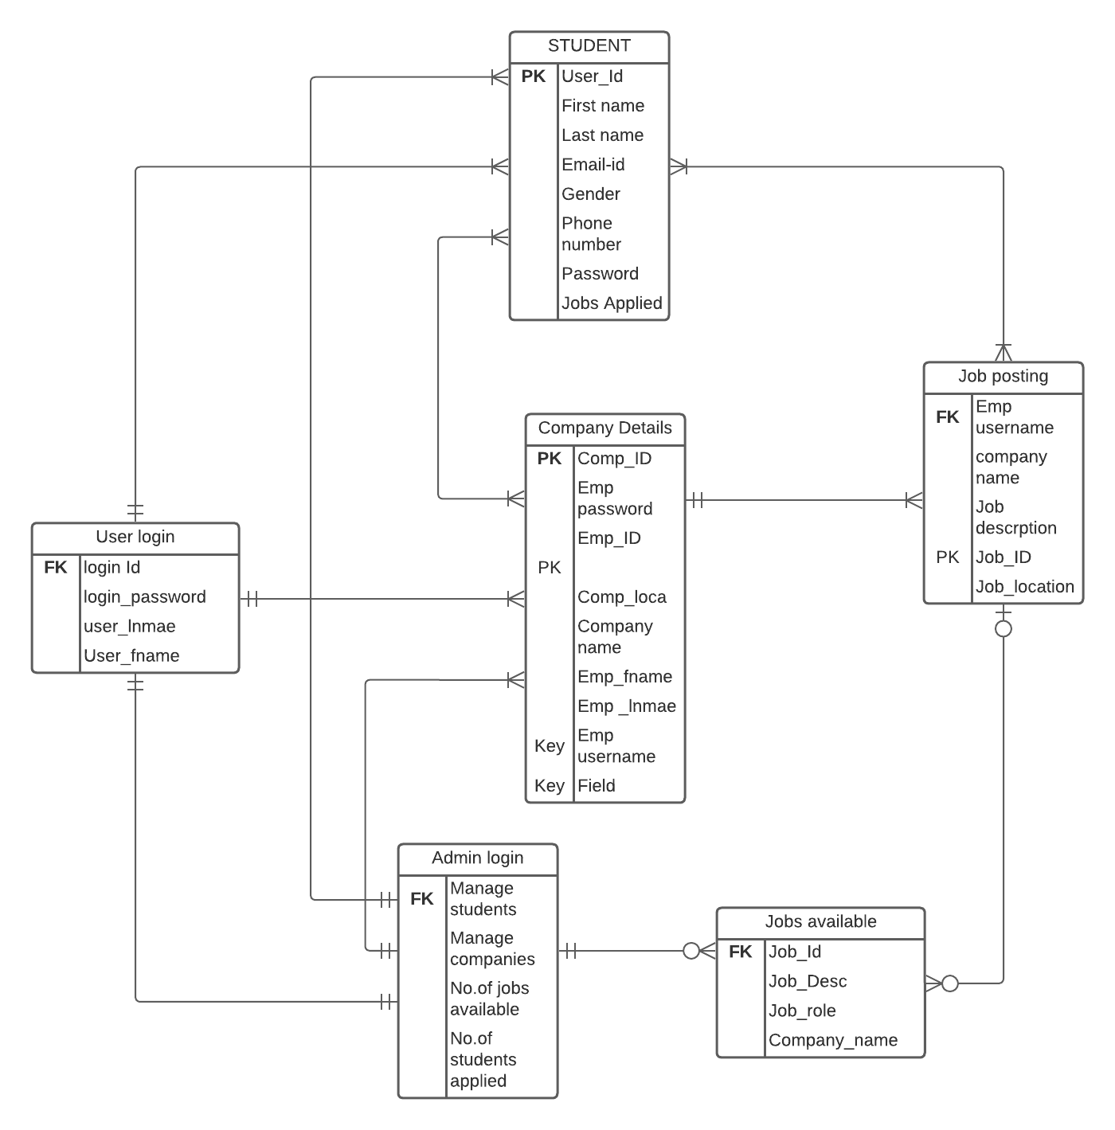
ER Diagram
Fig 11 : ER Diagram
Presenter: Parimalla Pokuri
26

Slide 27

DEMO……
Presenter: Sai Krishna Gadde
27

Slide 28
Company Login Entry
The company registration page consists of all the information about the company.
The HR's of the Company will register by providing the details of their company
Presenter: Sai Krishna Gadde
28

Slide 29
Admin Login Entry
There will be no registration required for admin login since we will give admin credentials.
In this way we can minimize the fake registrations for admin.
Presenter: Sai Krishna Gadde
29

Slide 30
Lessons Learnt:
We are new to this technology and usage of Robot 3T. At the start we faced issues for connecting the data.
We faced a challenge while learning NODE JS using in backend. It is like a daily challenge while we integrate new improvement in project.
Presenter: Manikanta Arumilli
30

Slide 31
Outcomes:
Till now we are successfully done with registration page and we are able to login which directs to the dashboard of particular login.
Successfully the signup data is stored in the database server using mongodb.
.
Presenter: Manikanta Arumilli
31

Slide 32
Future Implementations:
How admin can identify fake data and reject them
How students can apply for jobs
How a company can post job offers
Presenter: Manikanta Arumilli
32

Slide 33
Obstacles
When we are creating an admin page we came across an issue that any people can sign up as an admin and can get full powers of administrator which causes connection loss between students and companies by fake administrator.
Solution: Avoid Creating an account, but can get only login credentials by app developer to access his/her powers as an administrator.
Presenter: Manikanta Arumilli
33

Slide 34
Summary:
Developing a web application , which is useful for students to enhance their practical knowledge by gaining work experience.
Used html , css, node js , mongodb.
github link:
https://github.com/anushaporeddy030697/student_internship_management
Presenter: Manikanta Arumilli
34

Slide 35
TEAM - 04
SHASHANK CHENNU - Frontend
ANUSHA POREDDY-
DataBase and Team Lead
PARIMALLA POKURI -
Backend
SAI KRISHNA GADEE –
Backend
MANIKANTA ARUMILLI –
Frontend
Dr.CHANDRA MOULI KOTTETI
Client & Mentor
35

Slide 36
STUDENT INTERNSHIP MANAGEMENT SYSTEM

Slide 37


Slide 38

Thank You

